Slide 1

Обзор технологий Управления частным облаком на базе System Center 2012
MCP Club. Пермь. 27.09.2011
Горинов Максим: MCT, MCITP:Enterprise Administrator, MCSE:Security

Slide 2
Содержание
Обзор решений Microsoft для частных облаков
Обзор новых возможностей:
  SCVMM 2012
  SCCM 2012
  SCDPM 2012
Обзор новых продуктов линейки System Center:
  Project (codename Concero)
  Advisor (codename Atlanta)
  SCORC 2012

Slide 3
Обзор Решений Microsoft для частных облаков
Обзор технологий управления частным облаком на базе System Center 2012

Slide 4
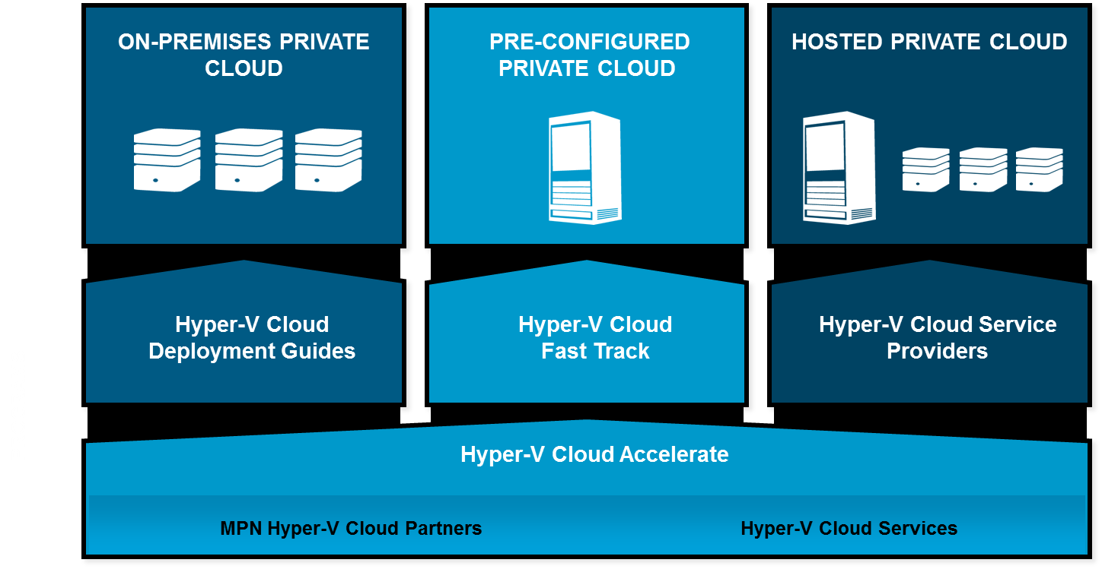
Решения Microsoft для частных облаков

Slide 5
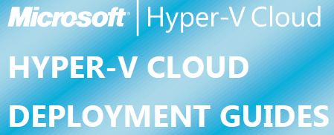
Hyper-V cloud deployment guides
M1: Architecture
M2: Deployment
M3: Operations
Validation Workbook
Project Plan Template

Slide 6
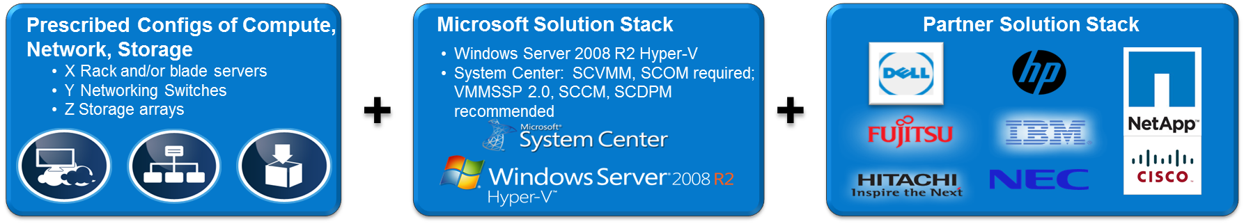
Hyper-V cloud Fast Track
Pre-configured Hyper-V cloud
Validated Configurations of Compute, Storage, Networking, Management Software

Slide 7
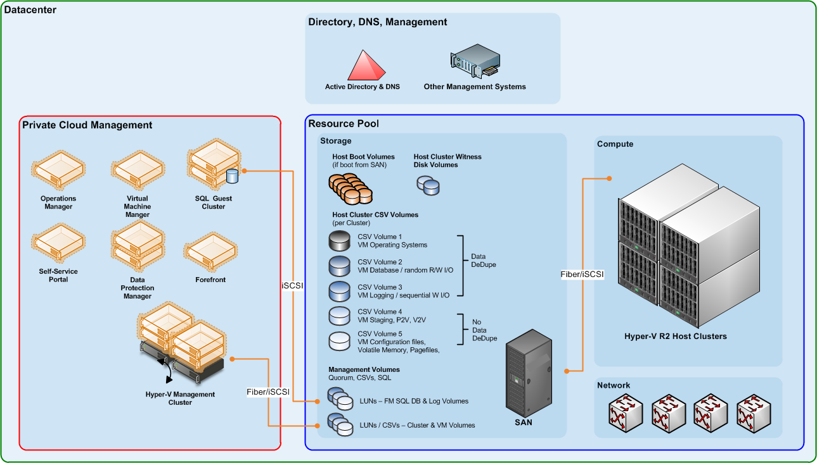
Логическая архитектура

Slide 8
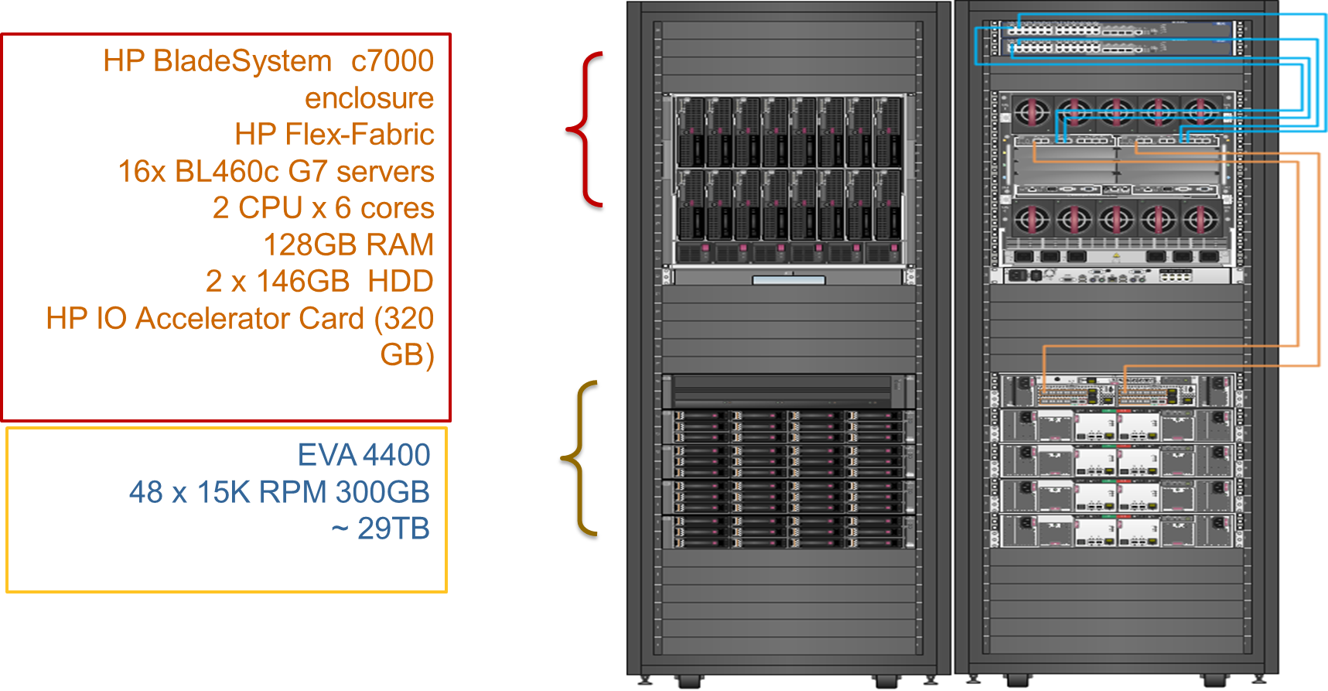
HP Cloud Foundation for Hyper-V

Slide 9
System center Virtual Machine manager 2012
Обзор технологий управления частным облаком на базе System Center 2012

Slide 10
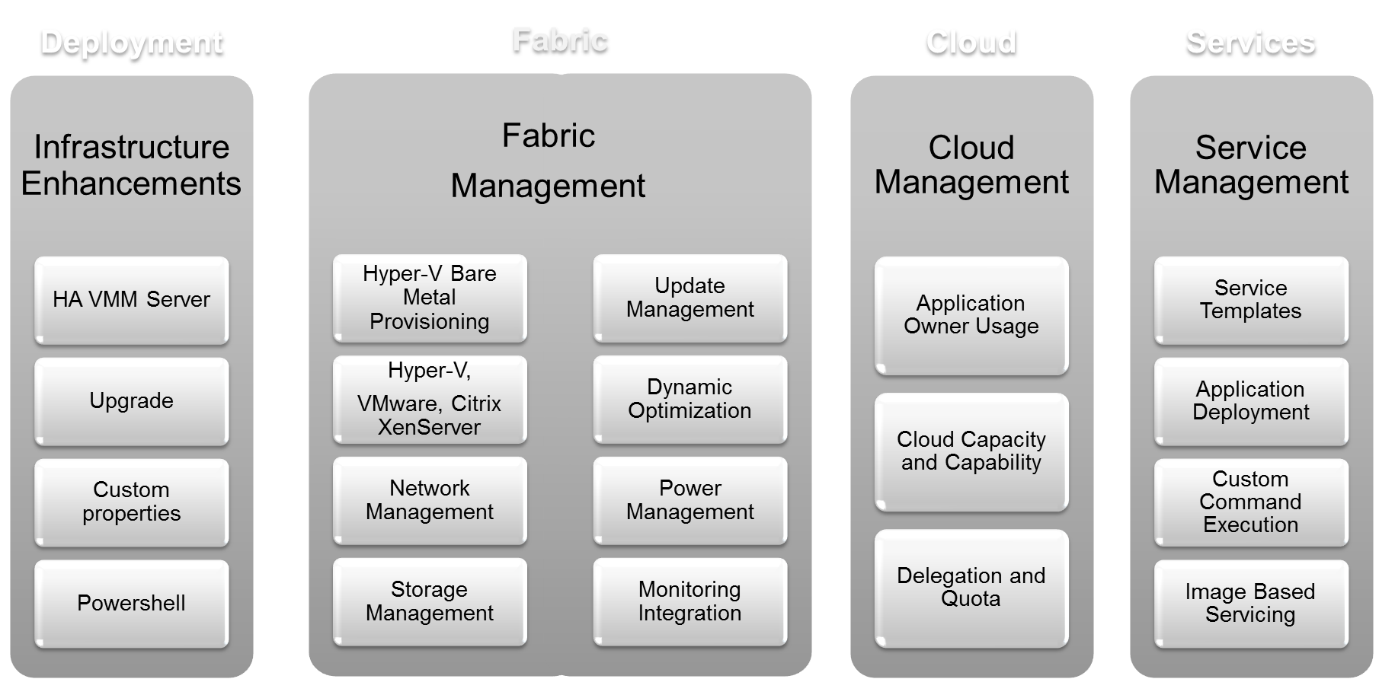
Направления улучшений в VMM 2012

Slide 11
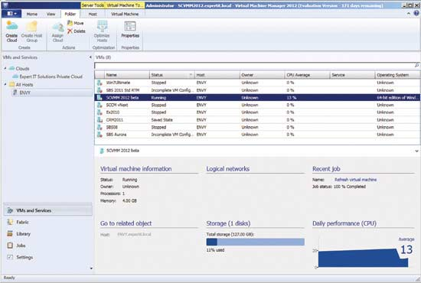
Частные облака

Slide 12
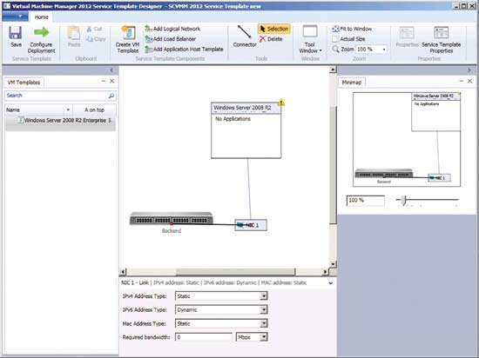
Службы

Slide 13
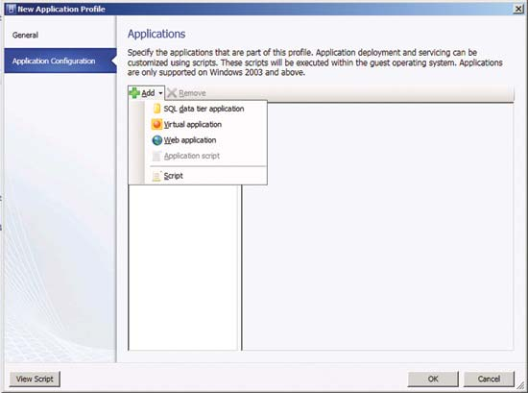
Приложения

Slide 14
System center project
Обзор технологий управления частным облаком на базе System Center 2012

Slide 15



Идеология System Center Project
Customer
Microsoft
Partner
Services
“Concero”
  Windows Azure Platform Appliance
  Windows Azure
  Windows Azure Platform Appliance
VMM 2012
VMM 2012
VMM 2012
VMM 2012
Fabric
VMM Future
  Hyper-V, VMware, Xen
  Hyper-V, VMware, Xen
  Hyper-V, VMware, Xen
  Hyper-V, VMware, Xen
  Hyper-V, VMware, Xen
  Hyper-V, VMware, Xen
Concero 1.0

Slide 16
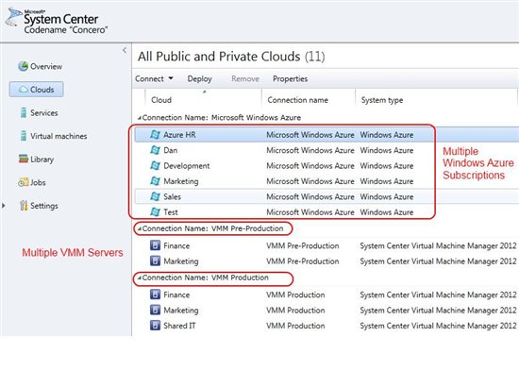
Возможности System Center Project
Ability to access resources across multiple VMM Servers
Ability to register and consume capacity from multiple Windows Azure subscriptions
Deploy and manage Services and virtual machines on private clouds created within VMM 2012 and on Windows Azure
Copy Service templates (and optional resources) from one VMM Server to another
Copy Windows Azure configuration, package files and VHD’s from on-premises and between Windows Azure subscriptions
Enable multiple users authenticated through Active Directory to access a single Windows Azure subscription

Slide 17
System center config manager 2012
Обзор технологий управления частным облаком на базе System Center 2012

Slide 18
Обзор новых возможностей SCCM 2012
User Centric Management
Conditional Delivery
Software Portal
Integrated Console
Automated Remediation
…

Slide 19
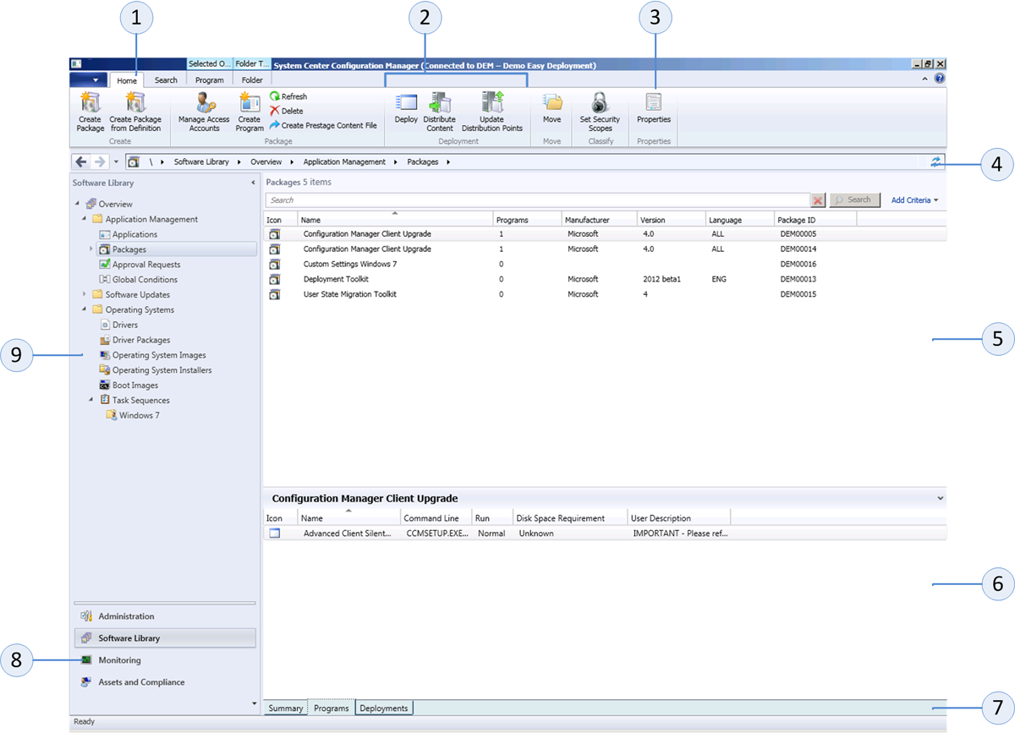
Новая консоль управления
Notes:
The tabs are contextual and appear only if an object or a subject is selected.
The commands are grouped by functionality and are also contextual and displayed on the ribbon.
Command or function within the group and available to use in combination with the selected object.
Breadcrumbs or navigator is used to quickly browse back to a page in the tree.
Objects of a selected feature. When selecting a feature, you are able to create related objects.
Selecting an object will give you straightaway information about the object or the possibility to change related objects
The information is grouped per tab.
The new Configuration Manager Console is divided into 4 work spaces in the wunderbar. These work spaces group the features of Configuration Manager in a logical way.
Features of the selected workspace. Since the features are grouped in nodes, selecting a node will change the list of features. Each feature has one of more subjects.

Slide 20
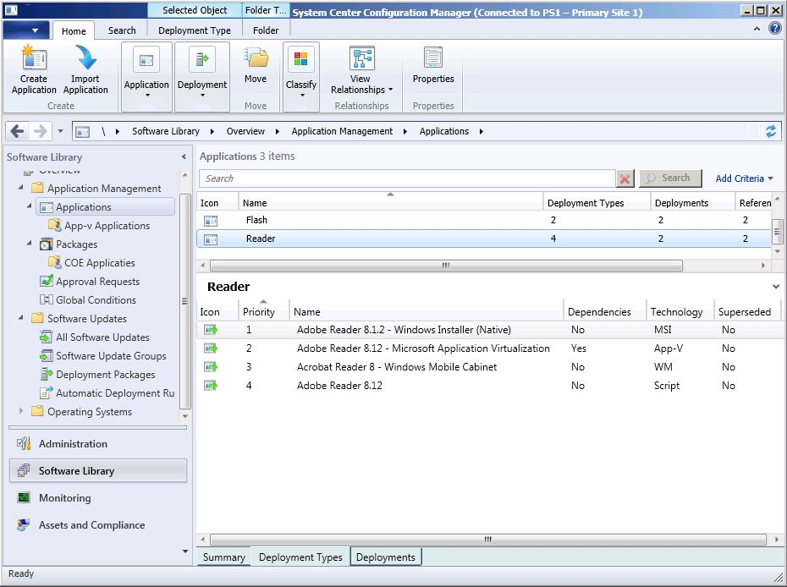
Типы развертываний ПО
Notes:
The MSI deployment type can be used on all you desktops and laptops
The App-v deployment type can be used in for instance a SBC environment
The Windows Mobile deployment type can be used for your Windows Mobiles clients
The Scripts deployment type can be used for customized deployments via Powershell scrip, VB Script or Java Script.

Slide 21
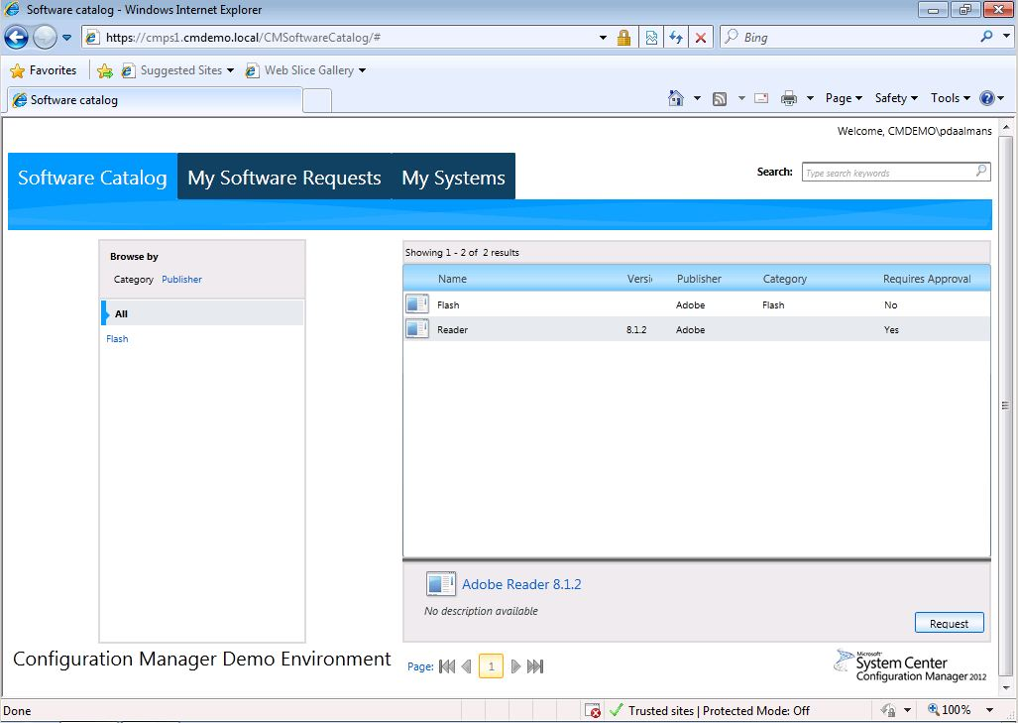
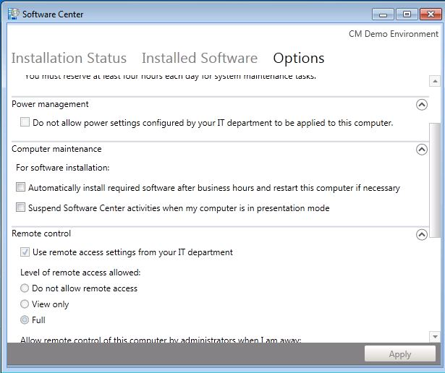
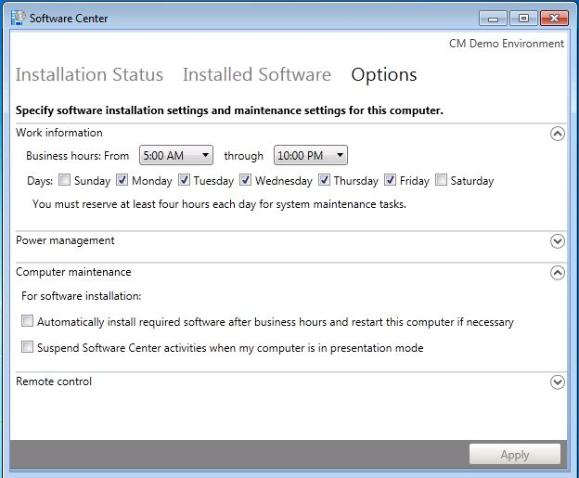
Software Portal

Slide 22
System center data protection manager 2012
Обзор технологий управления частным облаком на базе System Center 2012

Slide 23
Обзор новых возможностей SCDPM 2012
Centralized Management
Role-based management
Certificate Base Protection
Tape Media Co-location
SharePoint item-level recovery
Virtual DPM Enhancements
Generic Data Source Protection

Slide 24
System center advisor
Обзор технологий управления частным облаком на базе System Center 2012

Slide 25
Возможности System Center Advisor
Windows Server 2008 and later:
  Active Directory
  Hyper-V Host
  General operating system
SQL Server 2008 and later:
  SQL Engine

Slide 26
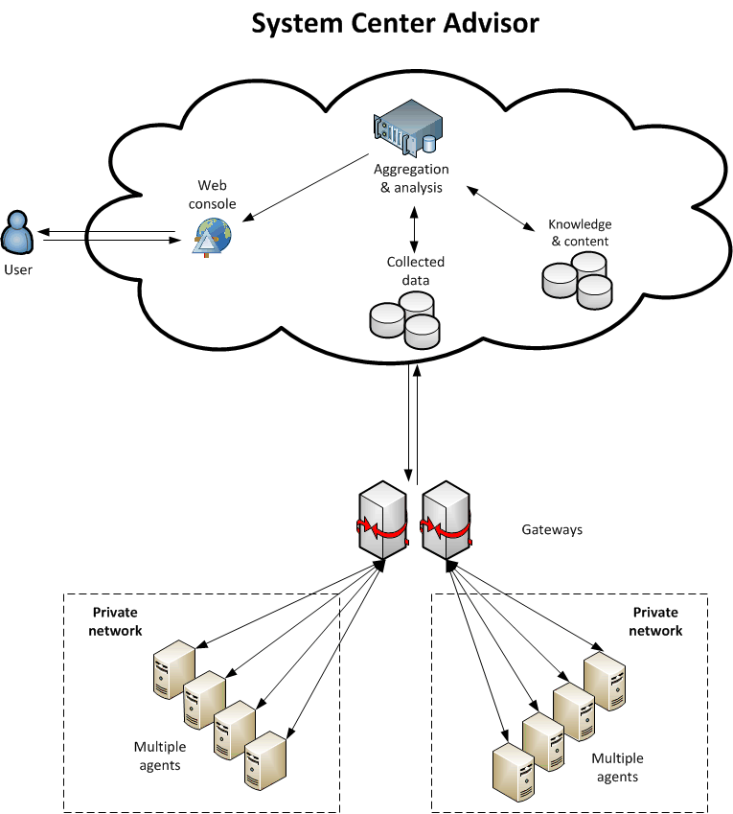
Архитектура System Center Advisor

Slide 27
System center orchestrator 2012
Обзор технологий управления частным облаком на базе System Center 2012

Slide 28
История Opalis
Opalis is a mature solution set
Founded in 1999
Current version is 6.3 (Nov 2010)
Acquired by Microsoft in December 2009
Opalis is a subsidiary of Microsoft
The current version of Opalis is a grant to Microsoft customers

Slide 29
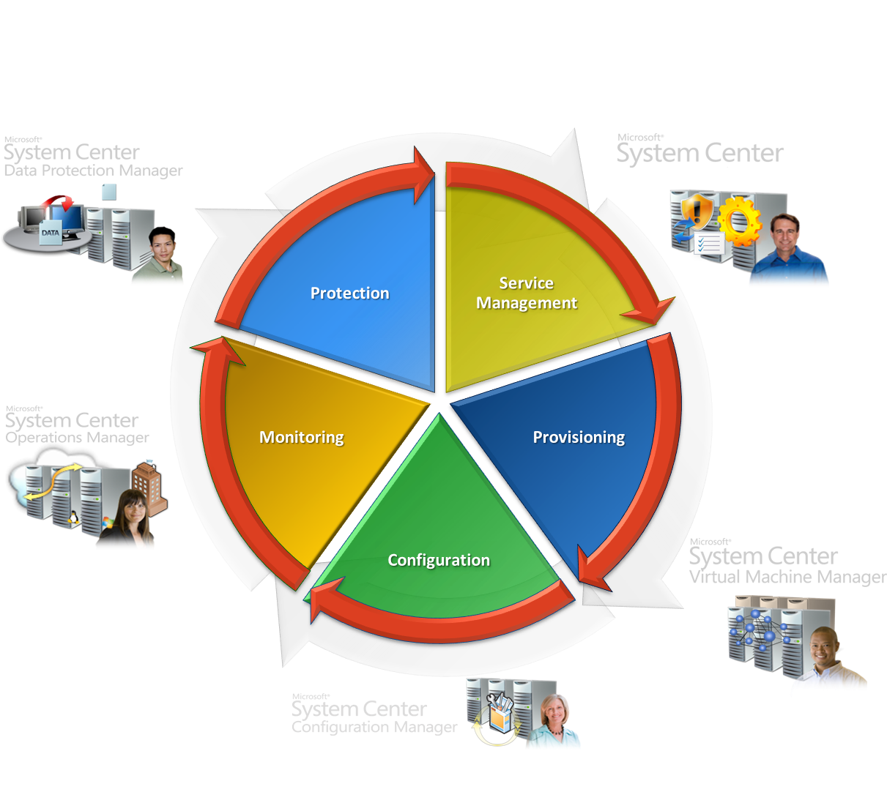
Идеология Orchestrator

Slide 30
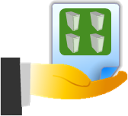
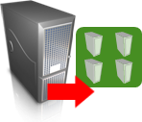

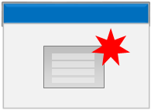

Концепции Opalis
Активности
Пакеты интеграции
Ранбуки (Runbooks)
Get Clone
Requests
Clone
VMs
Add Storage
To Each
Create
Advertisement
Protect
VMs

Slide 31






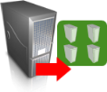



Event Mgmt
Monitor
for request
Service Desk
Initiate
Change
Update
CMDB
Close
Request
Asset/CMDB
Create
Deployment
Configuration
Clone
VM
Associate
Server to Service
Virtual
Security
Storage
Create
Disk
Connect
Disk to VM
Server
Create
Server
Network
Join
Network

Slide 32
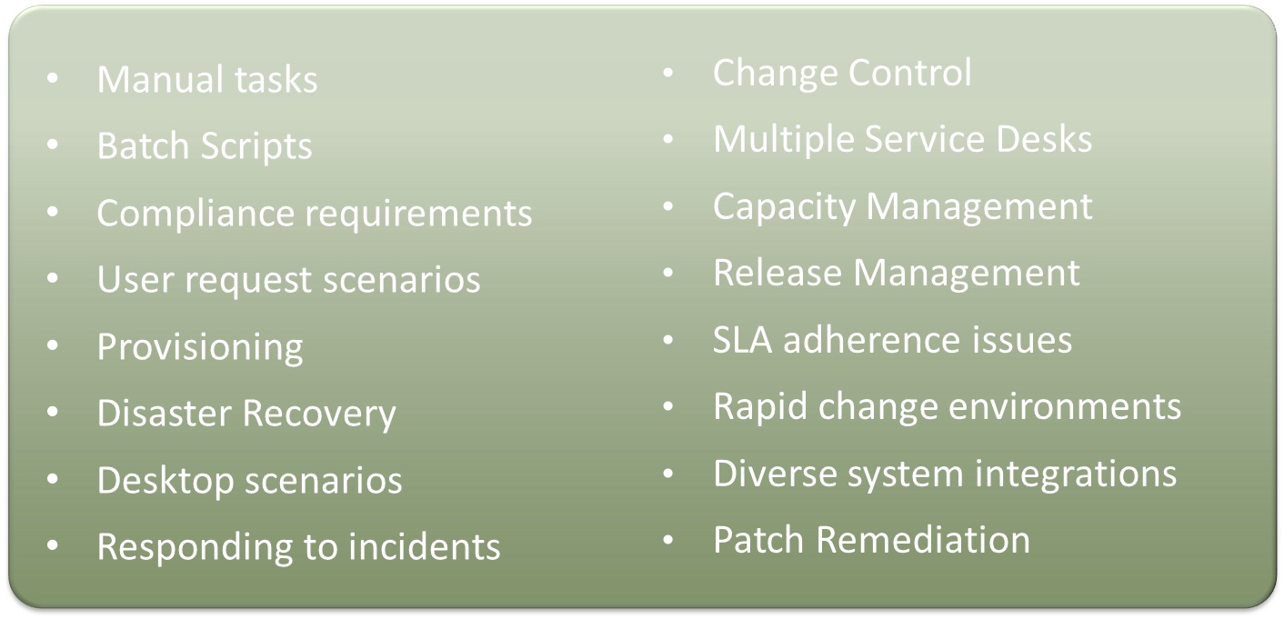
Возможные сценарии применения

Slide 33
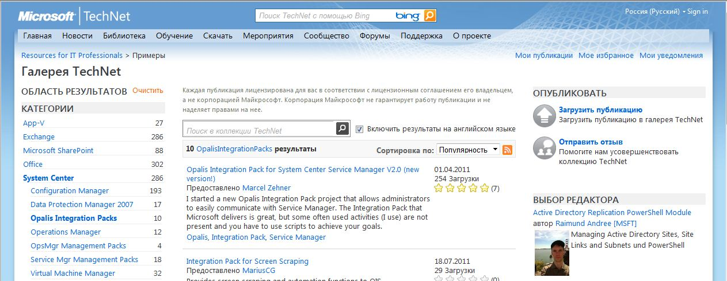
Пакеты интеграции
http://gallery.technet.microsoft.com

Slide 34
ДЕМО
System Center Orchestrator 2012

Slide 35

Вопросы
Обзор технологий управления частным облаком
на базе System Center 2012

Slide 36
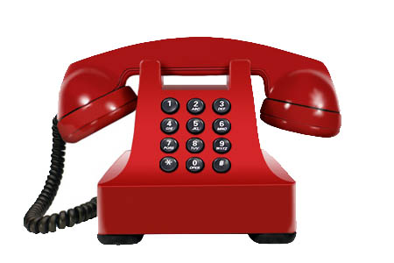
Контакты
E-Mail
  freeman199@mail.ru
ICQ
  369873932
Skype
  mgorinov59
Facebook
Горинов М. К. ©

