Slide 1
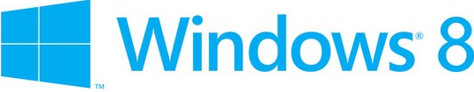
Windows server “8” beta Технический обзор MCP CLUB. пермь. Апрель 2012
Горинов Максим: MCT, MCITP:Enterprise Administrator
Горинов М. К. ©

Slide 2
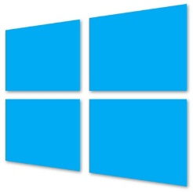
Новые и улучшенные технологии в Windows Server “8”
Active Directory
Hyper-V
Failover Clustering
Remote Desktop Services
File and Storage Services
Networking
Management
Server Core
Горинов М. К. ©

Slide 3
Windows Server “8”: Management
PowerShell 3.0
Server Manager
Offline VHD Deployment
Горинов М. К. ©

Slide 4
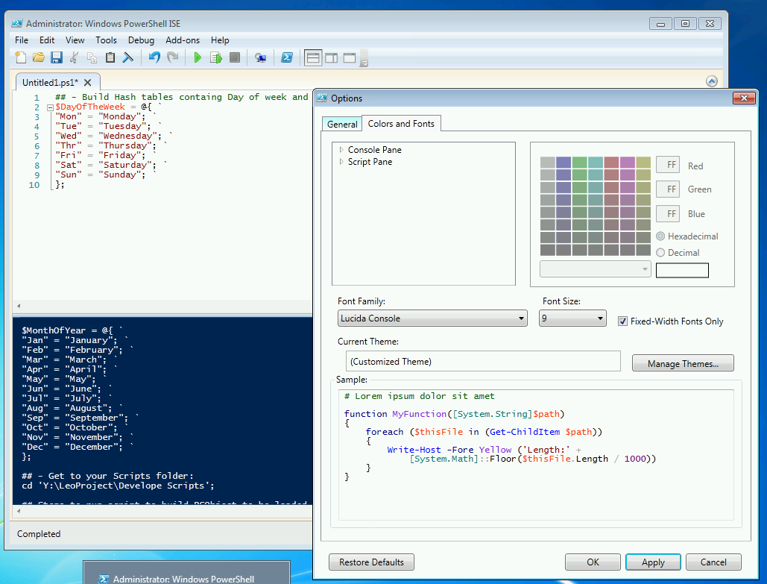
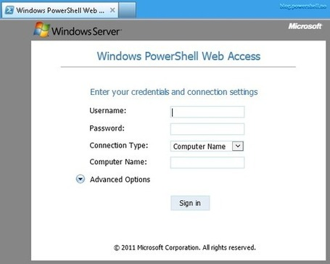
Management: PowerShell 3.0
PowerShell Workflow
Переподключение к удаленной сессии
PowerShell Web Access
Горинов М. К. ©

Slide 5
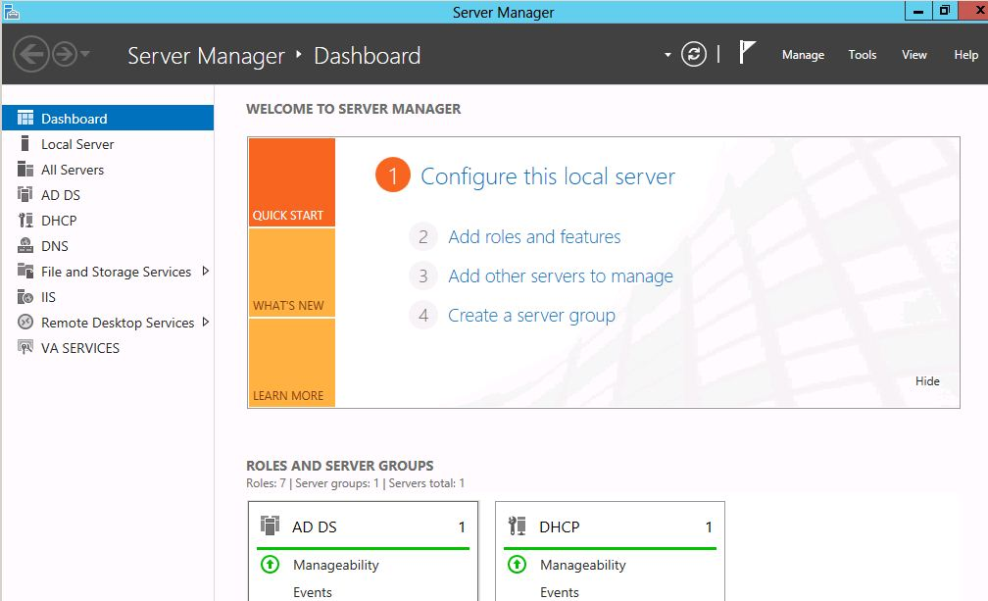
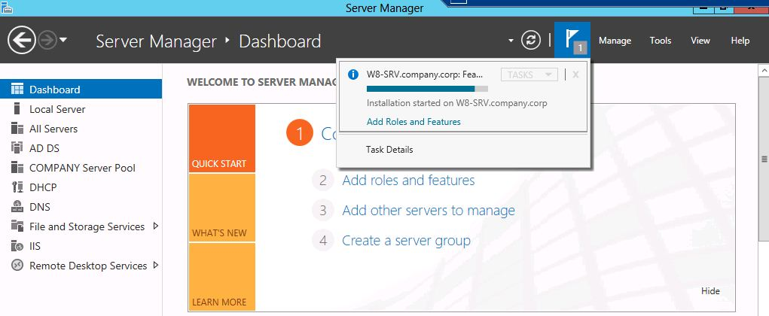
Management: Server Manager
WPF приложение накладываемое на PowerShell
Мультисерверное управление
File Storage Management
Remote Desktop Services
IP Address Management (IPAM)
Запуск утилит управления в контексте управляемого сервера
Горинов М. К. ©

Slide 6
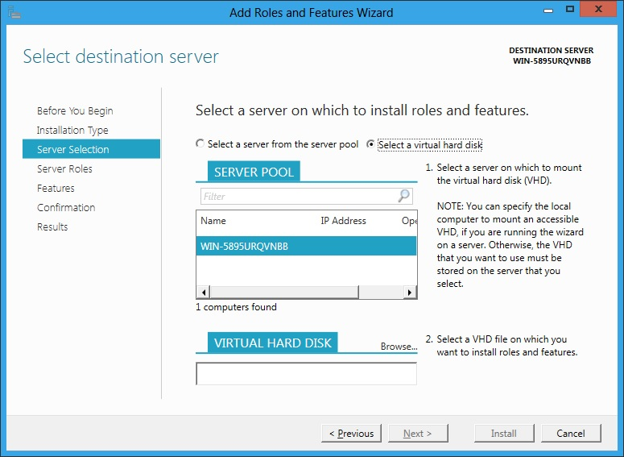
Management: Offline VHD Deployment
Offline Servicing для выключенных виртуальных машин
Горинов М. К. ©

Slide 7
Windows Server “8”: Active Directory
ADDS Configuration Wizard
DC Cloning
DC Virtualization
Dynamic Access Control
Горинов М. К. ©

Slide 8
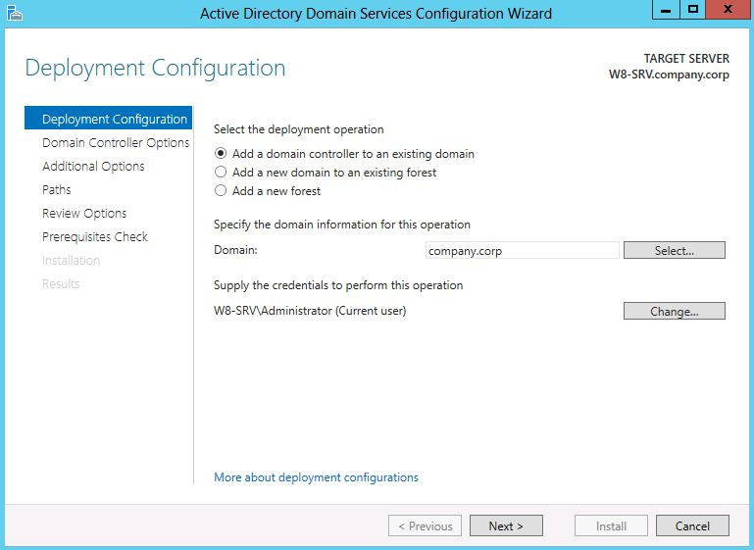
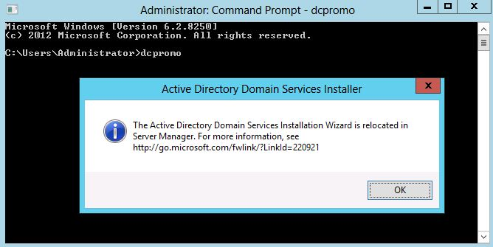
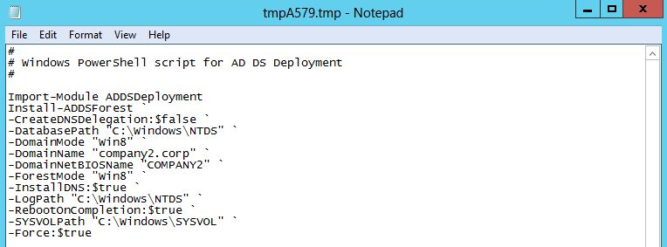
Active Directory: ADDS Configuration Wizard
Интеграция в Server Manager
DCPROMO
ADPREP
Возможность запуска на удаленных серверах
Визард позволяет экспортировать скрипт развертывания ADDS через PowerShell
Горинов М. К. ©

Slide 9
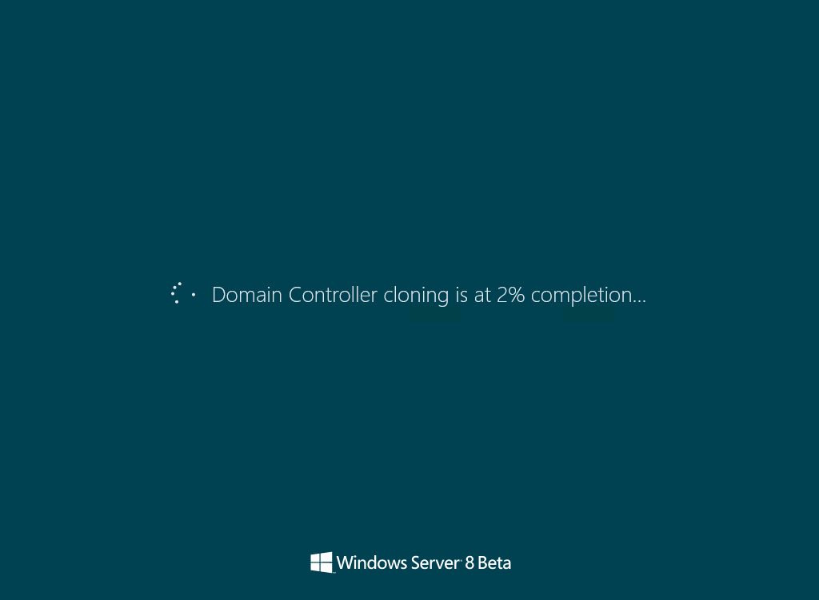
Active Directory: DC Cloning / DC Virtualization
Возможность клонирования виртуализованного доменного контроллера
Virtual machine Generation ID
Горинов М. К. ©
Notes:
http://terrytlslau.tls1.cc/2012/03/domain-controller-cloning-in-windows.html
AD DS has been virtualized for several years, but features present in most hypervisors can invalidate strong assumptions made by the Active Directory replication algorithms. Primarily, the logical clocks that are used by domain controllers to determine relative levels of convergence only go forward in time. In Windows Server “8” Beta, a virtual domain controller uses a unique identifier that is exposed by the hypervisor. This is called the virtual machine GenerationID. The virtual machine GenerationID changes whenever the virtual machine experiences an event that affects its position in time. The virtual machine GenerationID is exposed to the virtual machine’s address space within its BIOS, and it is made available to the operating system and applications through a driver in Windows Server “8” Beta.
During boot and before completing any transaction, a virtual domain controller running Windows Server “8” Beta compares the current value of the virtual machine GenerationID against the value that it stored in the directory. A mismatch is interpreted as a “rollback” event, and the domain controller employs AD DS safeguards that are new in Windows Server “8” Beta. These safeguards allow the virtual domain controller to converge with other domain controllers, and they prevent the virtual domain controller from creating duplicate security principals. For Windows Server “8” Beta virtual domain controllers to gain this extra level of protection, the virtual domain controller must be hosted on a virtual machine GenerationID–aware hypervisor such as Windows Server “8” Beta with the HyperV role.

Slide 10
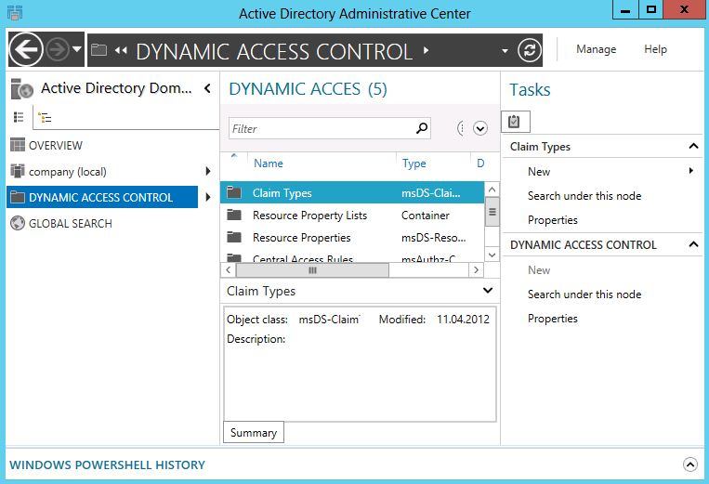
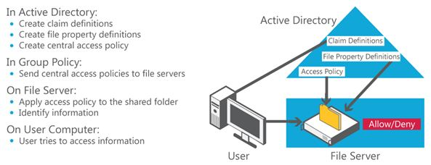
Active Directory: Dynamic Access Control
Новый движок аудита
Аудит доступа к файлам
Применение RMS шаблонов к файлам
Горинов М. К. ©

Slide 11
Windows Server “8”: Remote Desktop Services (RDS)
Архитектура
VDI Scenario-based Installation
RDS Scenario-based Installation
RemoteFX
Горинов М. К. ©

Slide 12
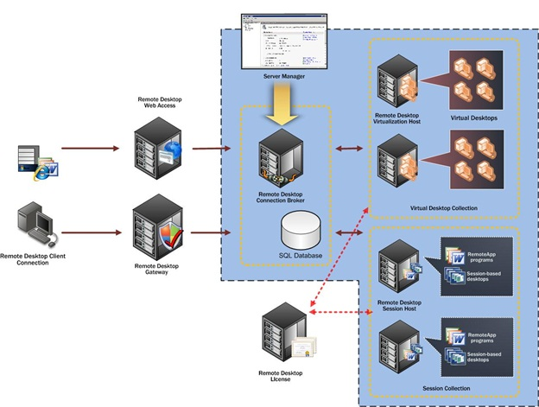
RDS: Архитектура
Горинов М. К. ©

Slide 13
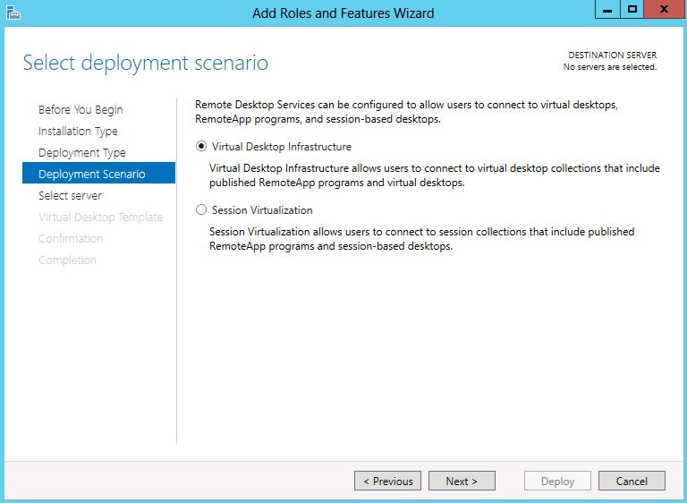
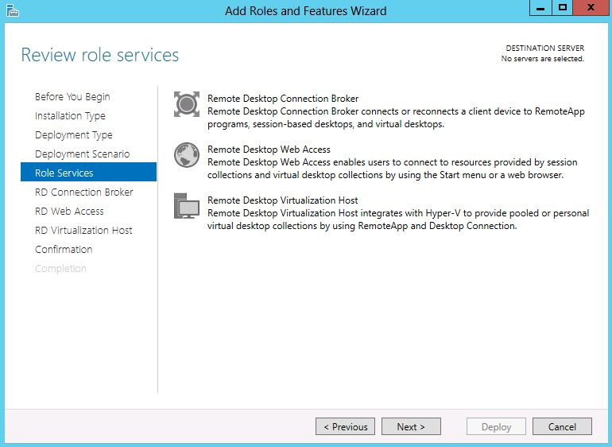
RDS: VDI Scenario-based Installation
Standard Deployment
Quick Start
RD Connection Broker
RD Web Access
RD Virtualization Host
Горинов М. К. ©

Slide 14
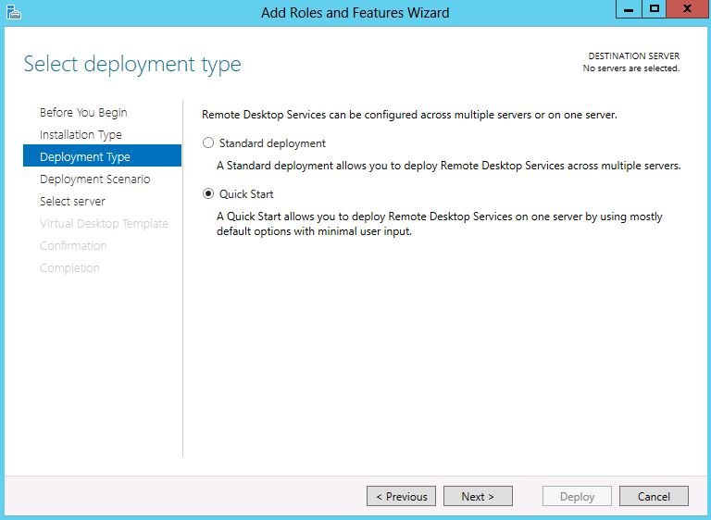
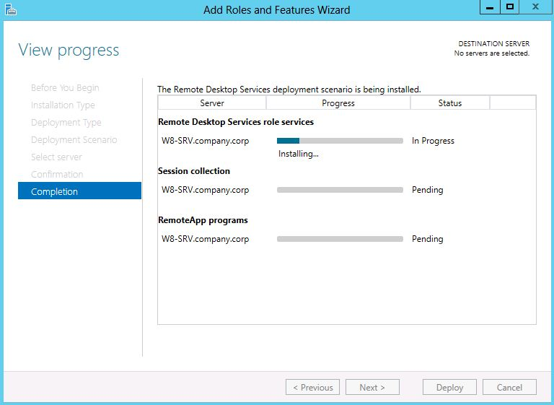
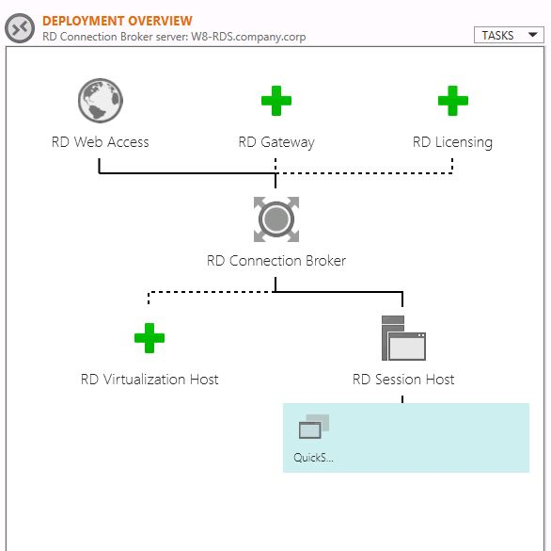
RDS: RDS Scenario-based Installation
Standard Deployment
Quick Start
RD Connection Broker
RD Web Access
RD Session Host
RemoteAPP Publishing
Горинов М. К. ©

Slide 15
RDS: RemoteFX
RemoteFX USB Redirection RDSH
All-in-One Printer
Scanner
Biometric
Webcam
VoIP
Оптимизированная производительность для WAN
RemoteFX Autodetect
RemoteFX Progressive Download
RemoteFX Media Streaming
Multitouch Redirection
Горинов М. К. ©

Slide 16
Windows Server “8”: Server Core
Архитектура
Поддерживаемые роли
Minimal Server Interface
Переключение между GUI / Core
Переключение между GUI / Core через PS
Переключение между Core / GUI
Горинов М. К. ©

Slide 17
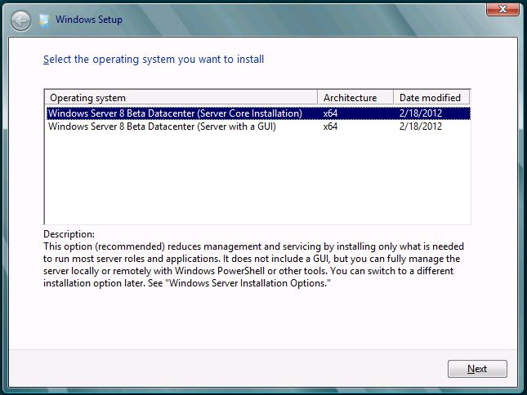
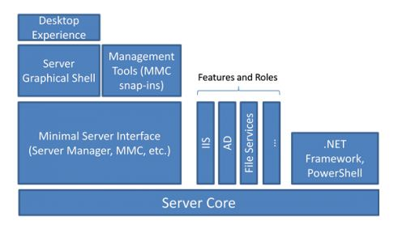
Server Core: Архитектура
Server Core:
Минимальная общая база для всех редакций Windows Server
Рекомендуемая по умолчанию опция установки ОС
Горинов М. К. ©

Slide 18
Server Core: Поддерживаемые роли
ADDS /ADCS / ADLDS / ADRMS
RRAS
DHCP
Streaming Media Server
DNS
Web Server
File and Storage Services
WSUS
Hyper-V
Print and Document Services
Горинов М. К. ©

Slide 19
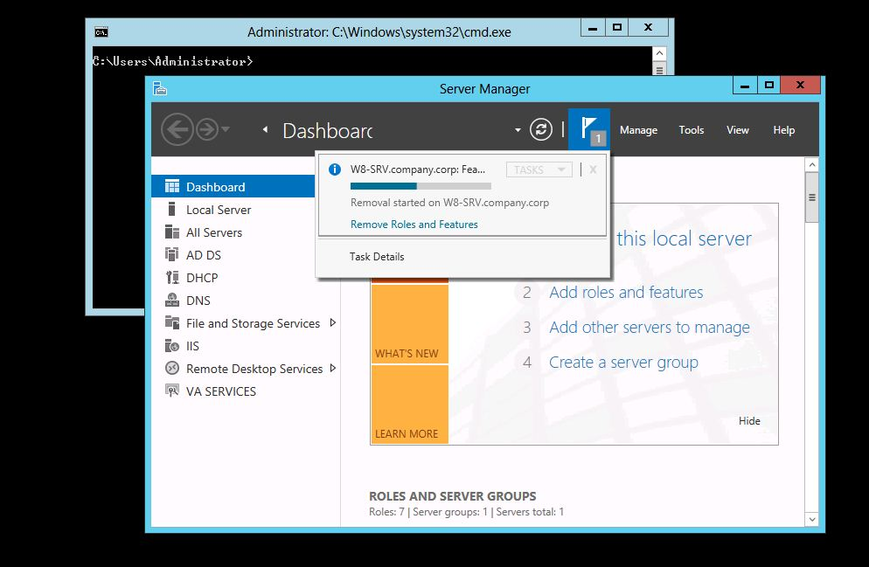
Server Core: Minimal Server Interface
Minimal Server Interface (исключает):
IE
Desktop
Explorer
Metro Apps support
Multimedia support
Desktop Experience
Горинов М. К. ©

Slide 20
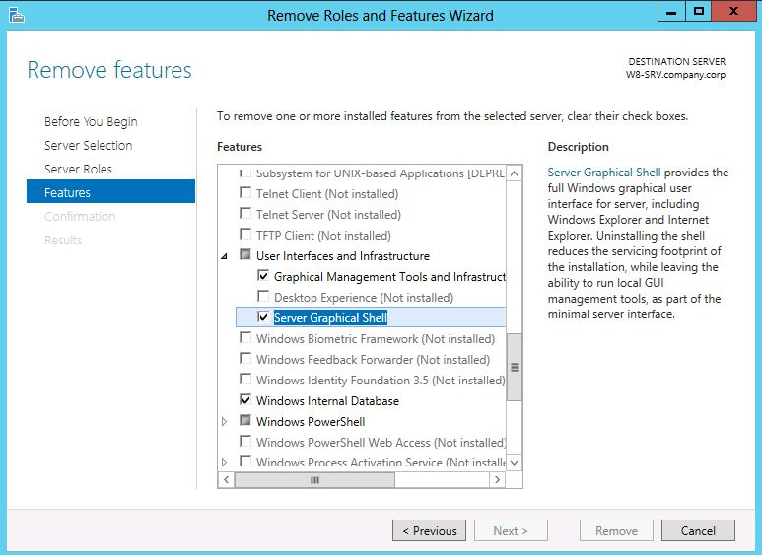
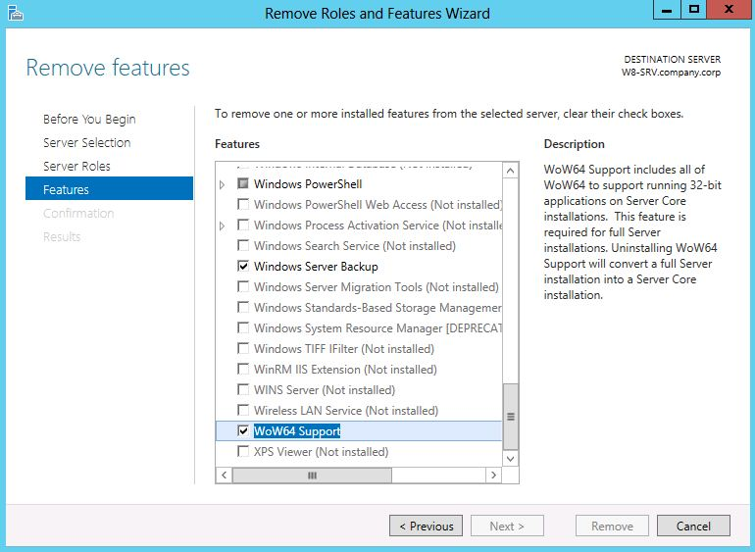
Server Core: Переключение между GUI / Core
Удалить только Server Graphical Shell = Minimal Server Interface
Удалить Server Graphical Shell + Graphical Management Tools + WoW64 = Server Core
Горинов М. К. ©

Slide 21
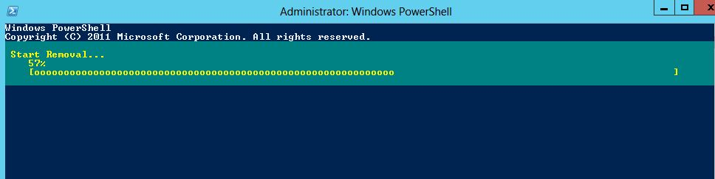
Server Core: Переключение между GUI / Core через PS
Uninstall-WindowsFeature Server-Gui-Mgmt-Infra –Restart
Горинов М. К. ©

Slide 22
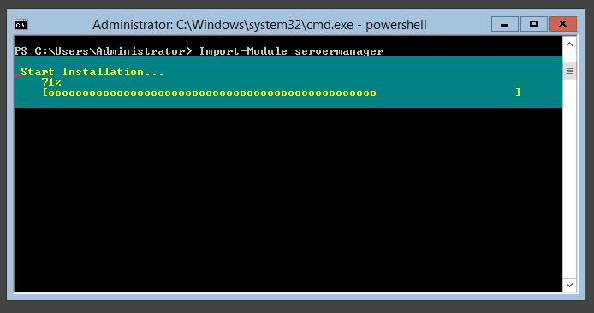
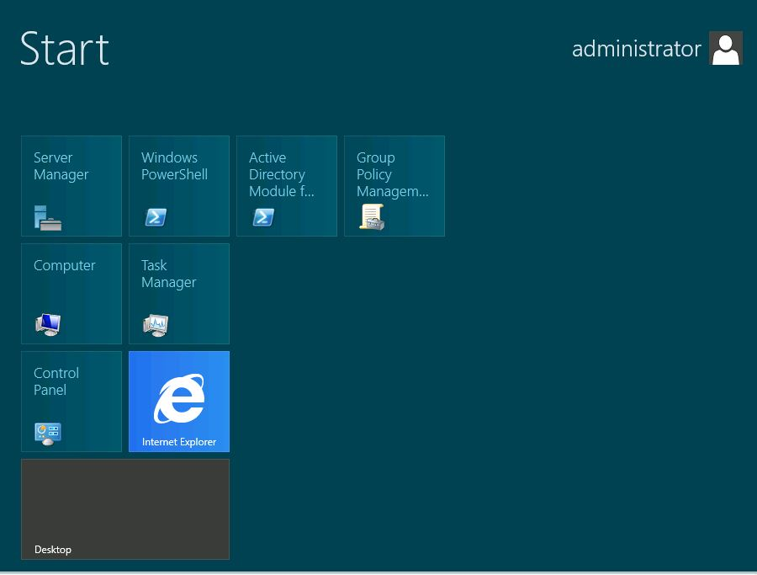
Server Core: Переключение между Core / GUI
Import-Module ServerManager
Add-WindowsFeature -Name 'Server-Gui-Shell' –Restart (Add-WindowsFeature -Name Server-Gui-Mgmt-Infra –Restart)
Горинов М. К. ©

Slide 23
Windows Server “8”: Hyper-V
Обзор новых возможностей
Обзор улучшенных возможностей
PowerShell Automation
Dynamic Memory
Hyper-V Replica
Virtual Machine Storage Migration
Virtual Machine Mobility
Горинов М. К. ©
Notes:
http://technet.microsoft.com/en-us/library/hh831410.aspx
http://www.thomasmaurer.ch/2011/09/hyper-v-version-3-kills-them-all/

Slide 24
Hyper-V: Новые возможности
Hyper-V module PowerShell
Storage Migration
Hyper-V Replica
SMB v2 File Share Storage
Resource Metering
Virtual Fibre Channel
Simplified Authorization
Storage Deduplication
SR-IOV
Offloaded Data Transfer
Горинов М. К. ©

Slide 25
Hyper-V: Улучшенные возможности
Dynamic Memory
VHDX / Large Sector Disk
Virtual Machine Mobility
Virtual Switch
Live Migration
Масштабируемость
Горинов М. К. ©
Notes:
http://technet.microsoft.com/ru-ru/library/hh831435.aspx

Slide 26
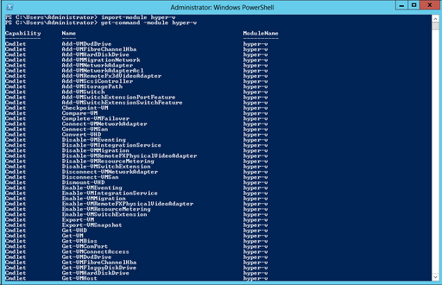
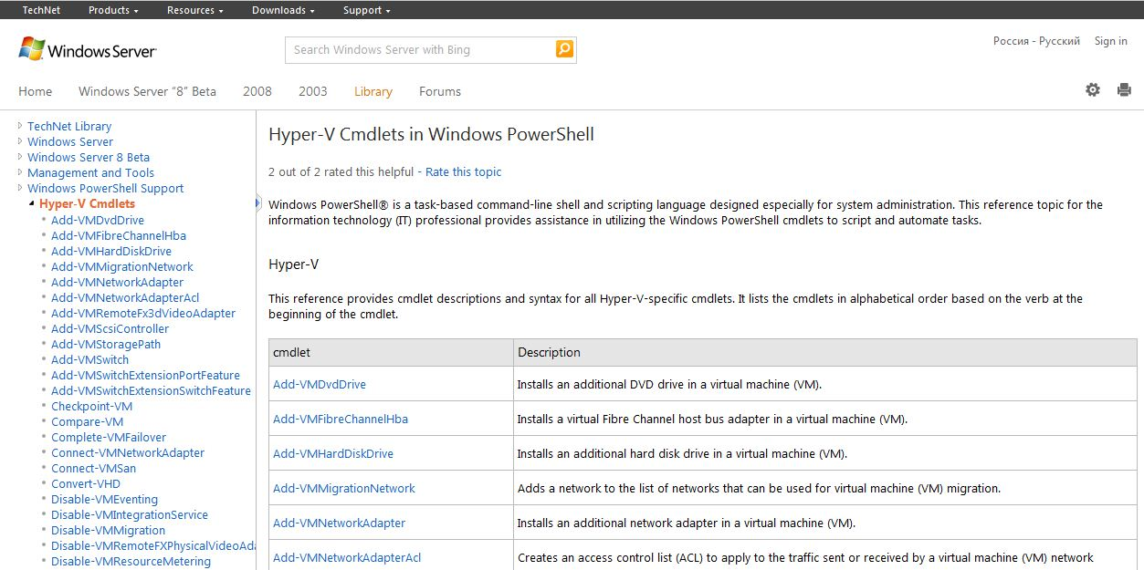
Hyper-V: PowerShell Automation
140+ командлетов для Hyper-V
Get-Command -Module Hyper-V
Get-Command -Module Hyper-V -Noun *host*
Get-VMHost -?
Get-Help Get-VMHost -Full
Горинов М. К. ©
Notes:
http://technet.microsoft.com/ru-ru/library/hh831705.aspx
http://technet.microsoft.com/en-us/library/hh848559.aspx

Slide 27
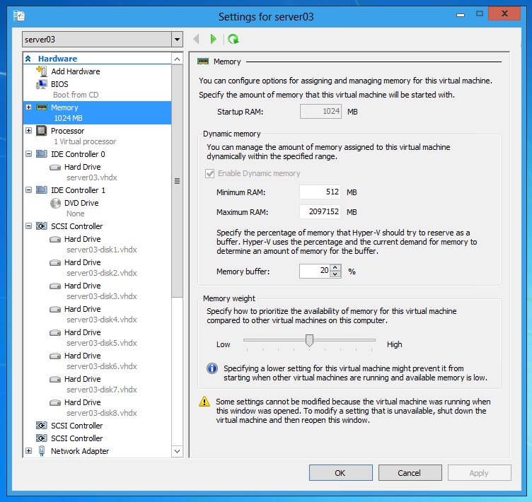
Hyper-V: Dynamic Memory
Minimum RAM
Smart Paging
Горинов М. К. ©

Slide 28
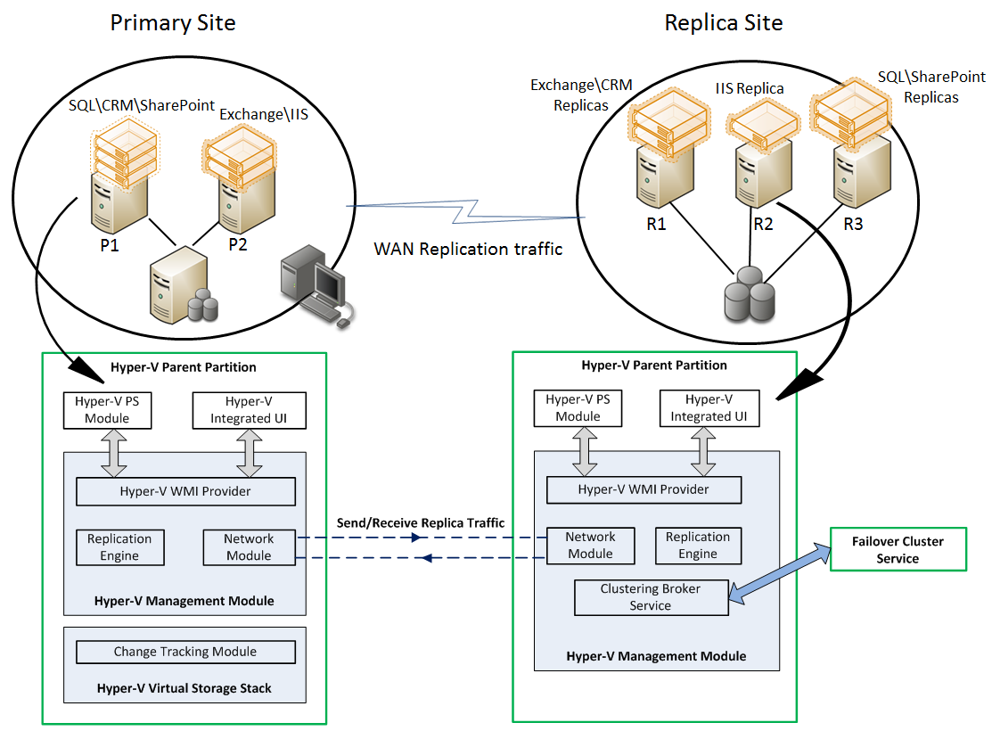
Hyper-V: Hyper-V Replica
Асинхронная репликация
Kerberos / Cert Auth
HTTP + шифрация
Горинов М. К. ©
Notes:
http://technet.microsoft.com/ru-ru/library/hh831716.aspx
http://www.hyper-v.nu/archives/pnoorderijk/2012/03/hyper-v-replica-powershell-cmdlets/

Slide 29
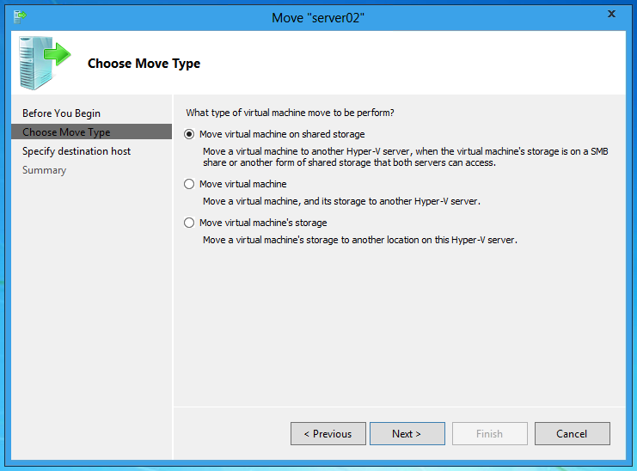
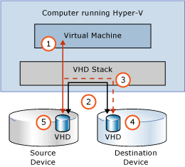
Hyper-V: Virtual Machine Storage Migration
SMB2.2 file share
Горинов М. К. ©
Notes:
http://technet.microsoft.com/ru-ru/library/hh831656.aspx
Throughout most of the move operation, disk reads and writes go to the source virtual hard disk.
While reads and writes occur on the source virtual hard disk, the disk contents are copied to the new destination virtual hard disk.
After the initial disk copy is complete, disk writes are mirrored to both the source and destination virtual hard disks while outstanding disk changes are replicated.
After the source and destination virtual hard disks are completely synchronized, the virtual machine switches over to using the destination virtual hard disk.
The source virtual hard disk is deleted.

Slide 30
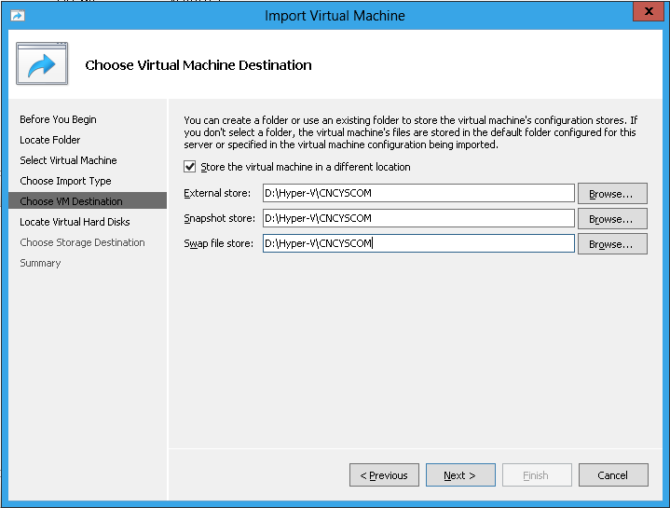
Hyper-V: Virtual Machine Mobility
Улучшенный визард импорта и экспорта VM
Горинов М. К. ©
Notes:
http://blog.concurrency.com/infrastructure/importing-a-virtual-machine-in-windows-8-hyper-v/

Slide 31
Windows Server “8”: Failover Clustering
Обзор новых возможностей
Cluster-Aware Updating
File Share Storage
Горинов М. К. ©

Slide 32
Clustering: Новые возможности
4000 VMs per cluster
64 Cluster nodes
Cluster Aware Updating
Queuing Live Migrations
CSV Bitlocker Support
Горинов М. К. ©

Slide 33
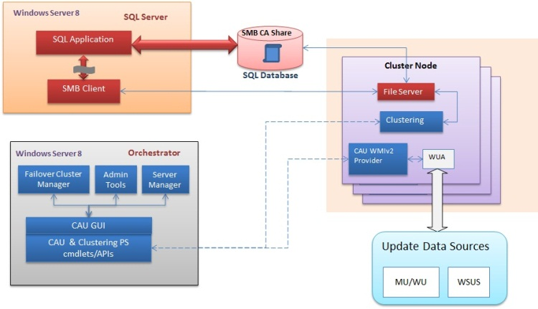
Failover Clustering: Cluster Aware Updating
Горинов М. К. ©
Notes:
http://robertsmit.wordpress.com/2011/09/15/windows-8-cluster-update-cauw-cluster-aware-update-wizard/
http://www.thomasmaurer.ch/2012/03/setup-windows-server-8-hyper-v-cluster/

Slide 34
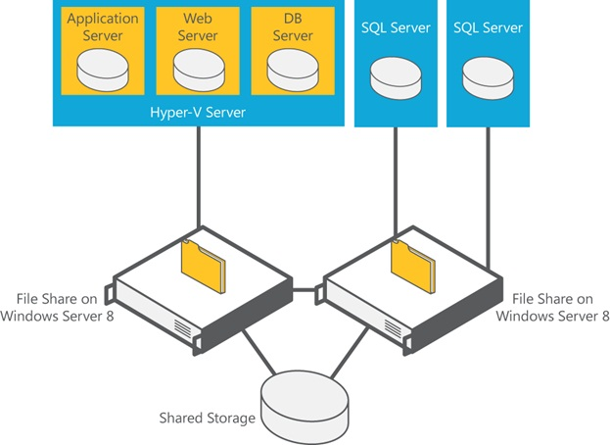
Failover Clustering: File Share Storage
Горинов М. К. ©

Slide 35
Windows Server “8”: Networking
DHCP High Availability
IP Address Management
Hyper-V Network Virtualization
Hyper-V Virtual Switch
Network Adapter Teaming
Горинов М. К. ©

Slide 36
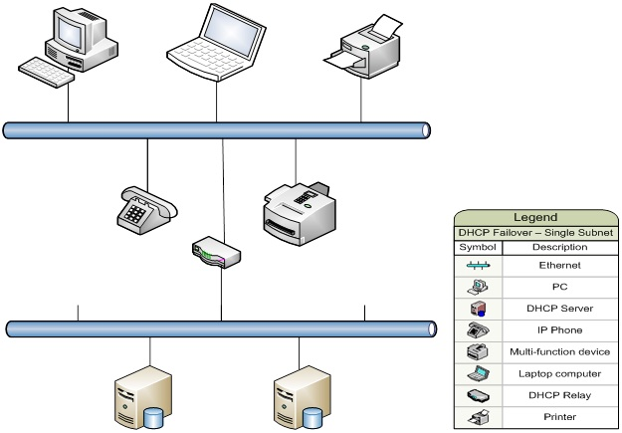
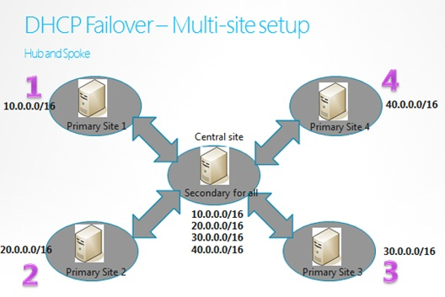
Networking: DHCP High Availability
DHCP Load Sharing Mode
Hot Standby Mode
Горинов М. К. ©

Slide 37
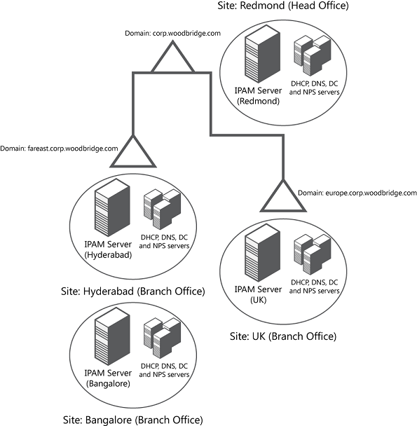
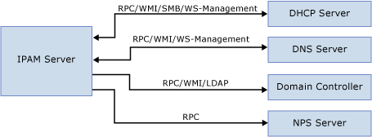
Networking: IP Address Management
Distributed IPAM
Centralized IPAM
Горинов М. К. ©

Slide 38
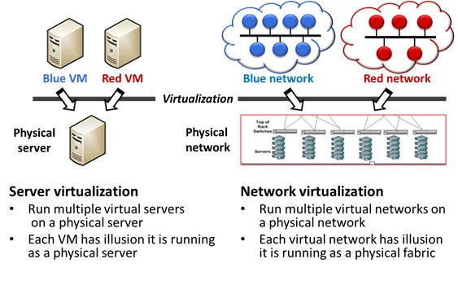
Networking: Hyper-V Network Virtualization
Горинов М. К. ©

Slide 39
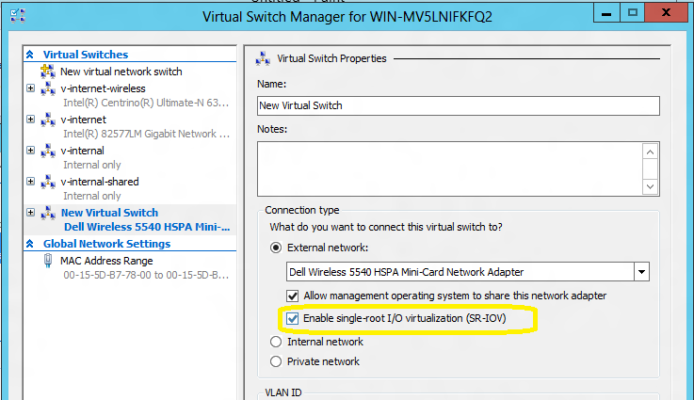
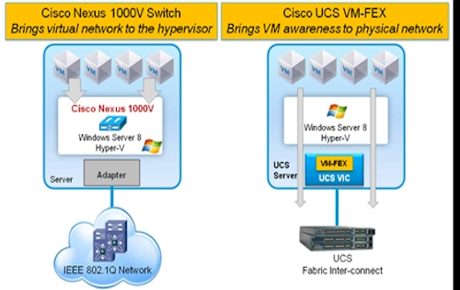
Networking: Hyper-V Virtual Switch
Open Platform
Запись событий в EventLog
Возможность установки расширений
Cisco Nexus 1000V
Горинов М. К. ©

Slide 40
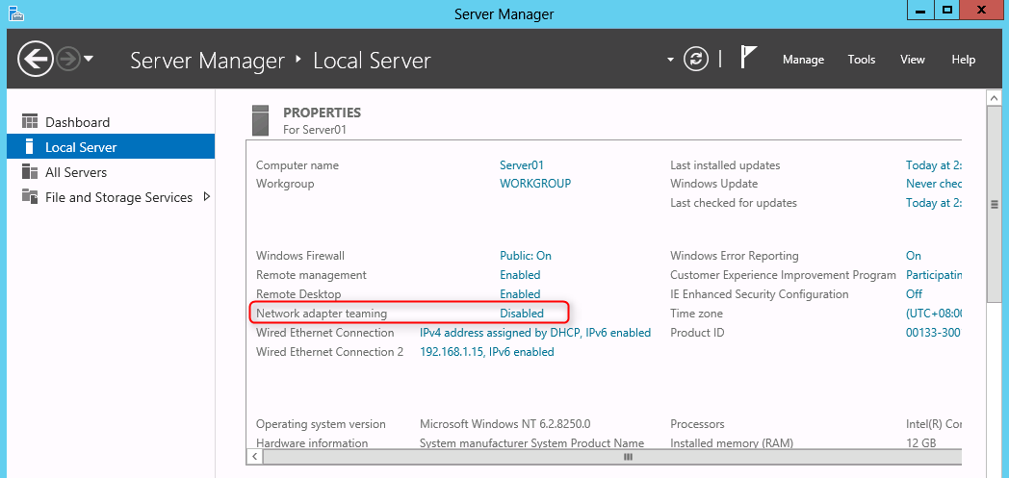
Networking: Network Adapter Teaming
Горинов М. К. ©

Slide 41
Windows Server “8”: File and Storage Services
Data Deduplication
Multiterabyte Volume
User Device Affinity
Горинов М. К. ©

Slide 42
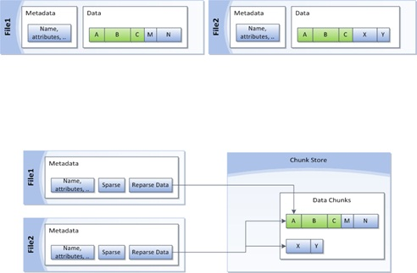
File and Storage Services: Data Deduplication
2:1 для файловых данных
20:1 для виртуальных машин
Горинов М. К. ©

Slide 43
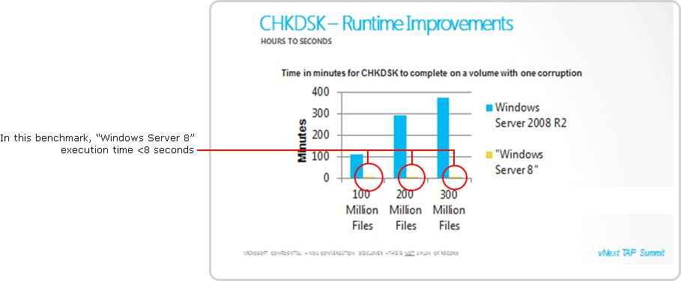
File and Storage Services: Multiterabyte Volume
Горинов М. К. ©

Slide 44
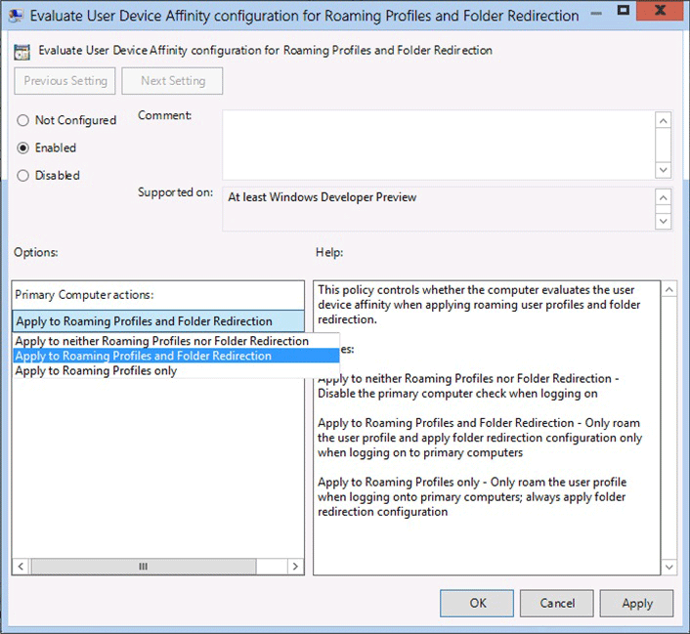
File and Storage Services: User Device Affinity
Горинов М. К. ©

Slide 45

Контакты: Горинов Максим
E-Mail
freeman199@mail.ru
ICQ
369873932
Skype
mgorinov59
Горинов М. К. ©

